Slide 1

WELCOME TO
SMART MARKET PRICE FORECASTER

Slide 2
Title : Smart Market Price Forecast Team Name : Nexus Network Member 1 : Gowsik Raja S Member 2 : Aditya A Member 3 : Akash N A Member 4 : Anandhraj G Department : B.E.CSE(Cyber Security) and B.Tech-IT College : SRM Madurai College For Engineering And Technology

Slide 3
INTRODUCTION
Smart Market Price Forecasting uses AI, machine learning, and big data analytics to predict market trends with high accuracy. Unlike traditional methods, smart forecasting adapts to real-time data, economic indicators, and external factors to enhance precision. It is widely used in stock markets, commodities, real estate, and retail to optimize pricing strategies and minimize risks. By leveraging advanced algorithms, businesses can make informed decisions and stay competitive in dynamic market conditions.

Slide 4
PROBLEM STATEMENT:
Farmers lack real time market insights,causing them to sell produce at low prices.
By creating a GenAI-powder price prediction tools that analyzes historical market data, demands- supply trends and weather impact to suggest the best time for selling crops.

Slide 5
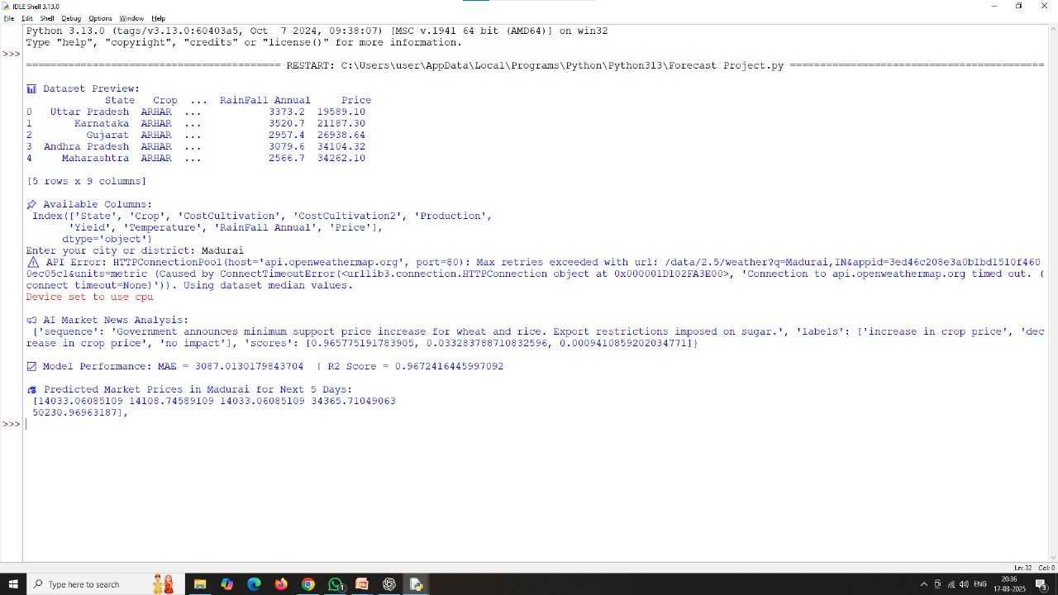
PYTHON SOLUTION SCREENSHOT:

Slide 6
CONCLUSION:
This project helps farmers and traders make informed decisions by *leveraging AI, ML, and real-time weather analysis. By integrating a **Flask API with an interactive web interface*, users can easily access predictions and plan their agricultural strategies.

